Slide 1


Modelisation of laser pulse heating of GST225 and GGSTN layers using COMSOL
Simon Schmit, July 2025

Slide 2
Plan of the presentation
Both configuration
Configurations 1 and 2
Impact of the GST layers thickness
Plateau temperature vs laser power
Parameters and properties :
Temperature vs time
Temperature vs depth
Single GST layer
Temperature vs time
Temperature vs depth
Characteristic time

Slide 3
Parameters and properties: materials and geometry
GST layers properties
Configuration 1
Configuration 2
Properties | a-GST | c-GST | a-GGSTN | c-GGSTN
A : Absorption coefficient for 1070 nm (1/m) | 8.76E+06 | 3.78E+07 | 4.28E+06 | 1.33E+07
k : Thermal conductivity W/(m*K) | 0.2 | 0.45 | 0.28 | 1.8
TiN (20 nm)
TiN (20 nm)
GGSTN (45 nm)
GST (5 nm)
GGSTN (45 nm)
GST (5 nm)
Si (substrate)
Si (substrate)
1000 um length
1000 um length

Slide 4
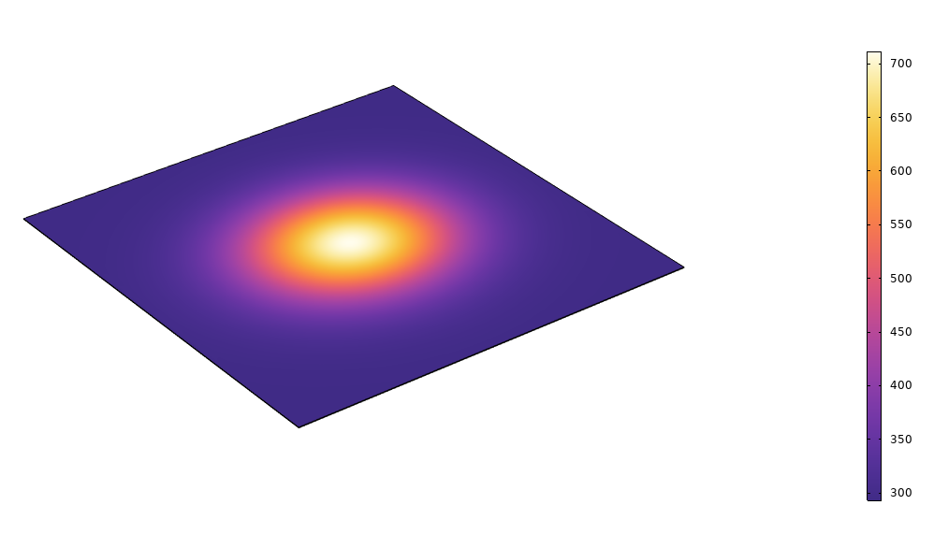
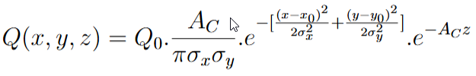
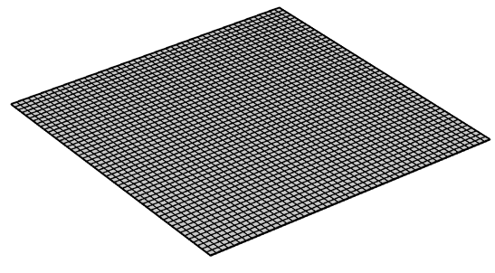
Parameters and properties: simulation parameters
Gaussian heat input
Thermal profile
Laser parameters
Mesh
Beam x-radius | 170 um
Beam y-radius | 150 um
Power | 300 W
Pulse duration | 1 us
Wavelength | 1700 nm
Fluence | 0.3745 J/cm²

Slide 5
Configuration 1: temperature vs time (x=0,y=0,z=0)
20 nm
100 nm

Slide 6
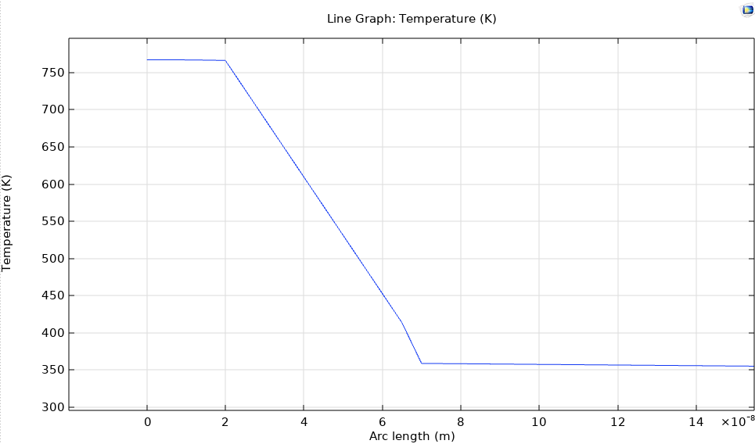
Configuration 1/ amorphous phase: temperature vs depth (10⁻⁸ m) (x=0, y=0)
20 nm
100 nm
TiN
GGSTN
Si
GST

Slide 7
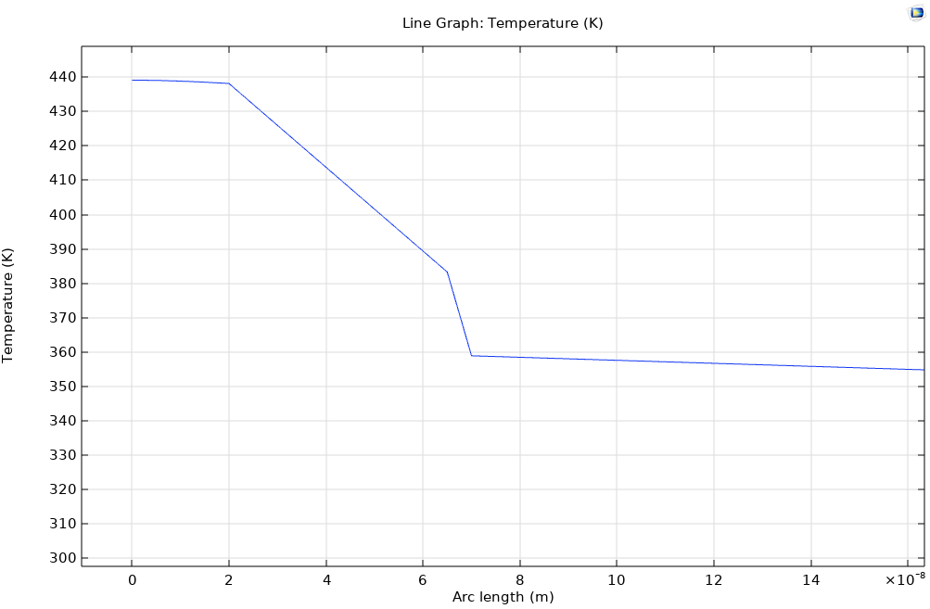
Configuration 1/ crystalline phase: temperature vs depth (10⁻⁸ m) (x=0, y=0)
20 nm
100 nm
TiN
GGSTN
GST
Si

Slide 8
Configuration 2: temperature vs time (x=0,y=0,z=0)
20 nm
100 nm

Slide 9
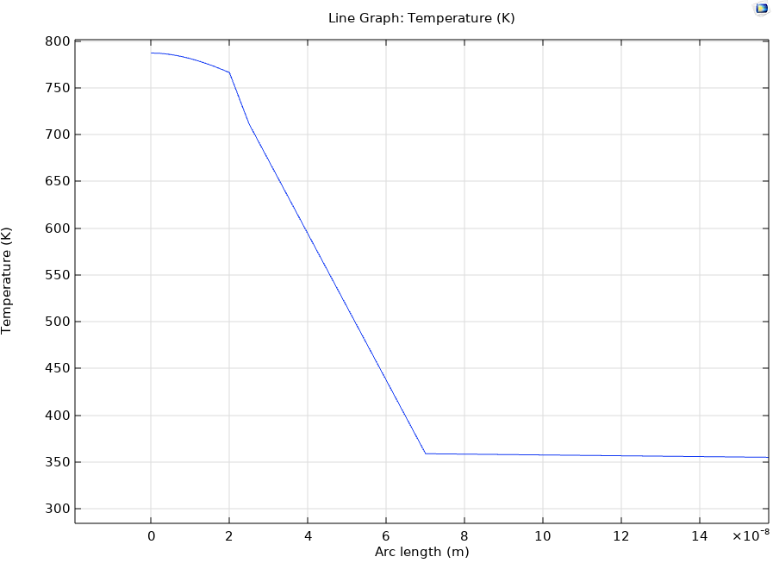
Configuration 2/ amorphous phase: temperature vs depth (10⁻⁸ m) (x=0, y=0)
20 nm
100 nm
TiN
GST
GGSTN
Si

Slide 10
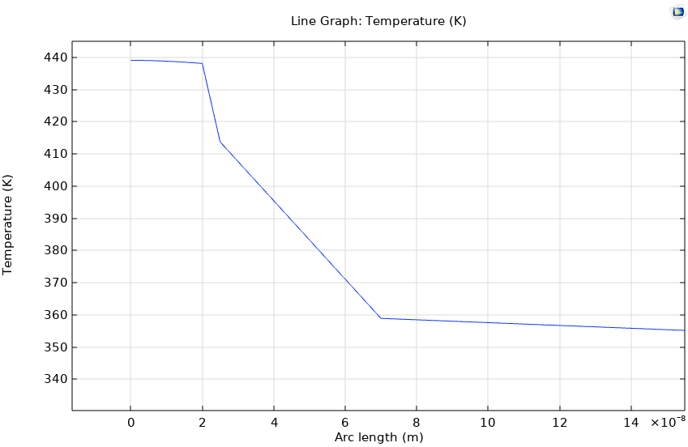
Configuration 2/ crystalline phase: temperature vs depth (10⁻⁸ m) (x=0, y=0)
20 nm
100 nm
TiN
GST
GGSTN
Si

Slide 11
Plateau temperature vs laser power
20 nm
100 nm
Laser Power (W) | Amorphous temperature (K) | Crystalline temperature (K)
100 | 457.93 | 341.81
200 | 609.2 | 390.46
300 | 767.23 | 439.12
400 | 925.25 | 487.77
500 | 1083.3 | 536.43
600 | 1241.3 | 585.09
Pulse duration : 1 us

Slide 12
Only GGSTN layer (300W, 1us)
Temperature vs time
Configuration
TiN (20 nm)
GGSTN (50 nm)
Si (substrate)
1000 um length

Slide 13
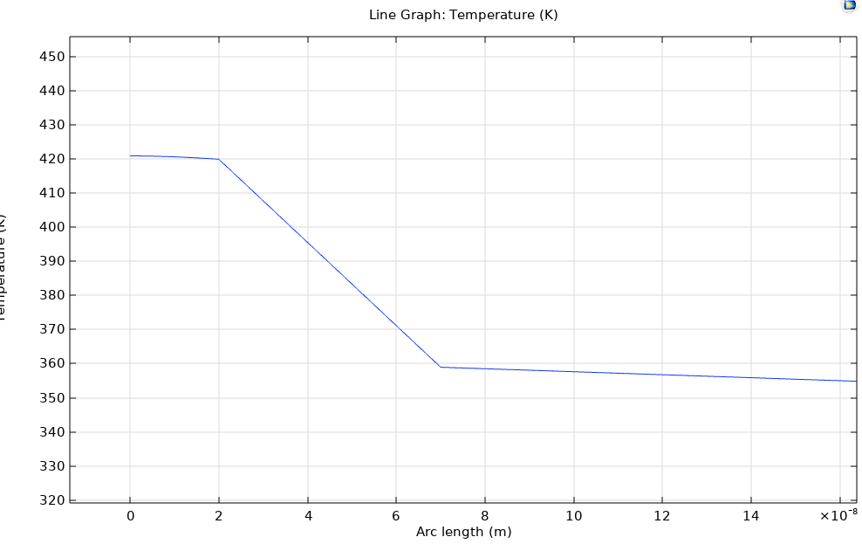
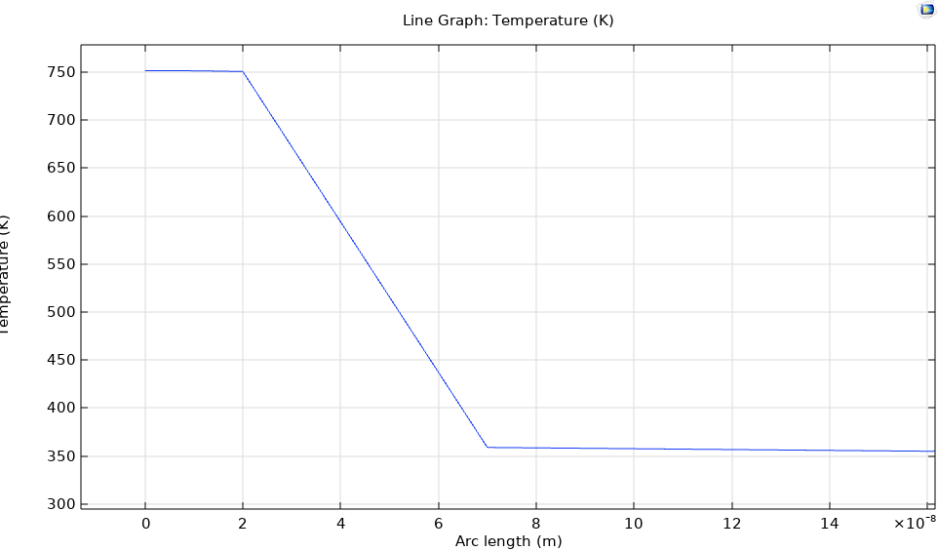
Only GGSTN layer (300W, 1us): temperature vs depth (10⁻⁸ m)
Crystalline
Amorphous
TiN
TiN
GGSTN
GGSTN
Si
Si

Slide 14
Only GST layer (300W): characteristic time
Configuration
TiN (20 nm)
GST (100 nm)
Si (substrate)
Pulse duration | Characteristic time
10 | 4.90E-09
100 | 0.000000023
250 | 3.56E-08
400 | 3.59E-08
500 | 3.59E-08
750 | 3.59E-08
1000 | 3.59E-08
1000 um length

